Slide 1
Using WordPress to Contextualize and Publish Digital Repository Content

Slide 2
The Problem

Slide 3
Our Solution

Slide 4
Collaborative Development Principles

Slide 5
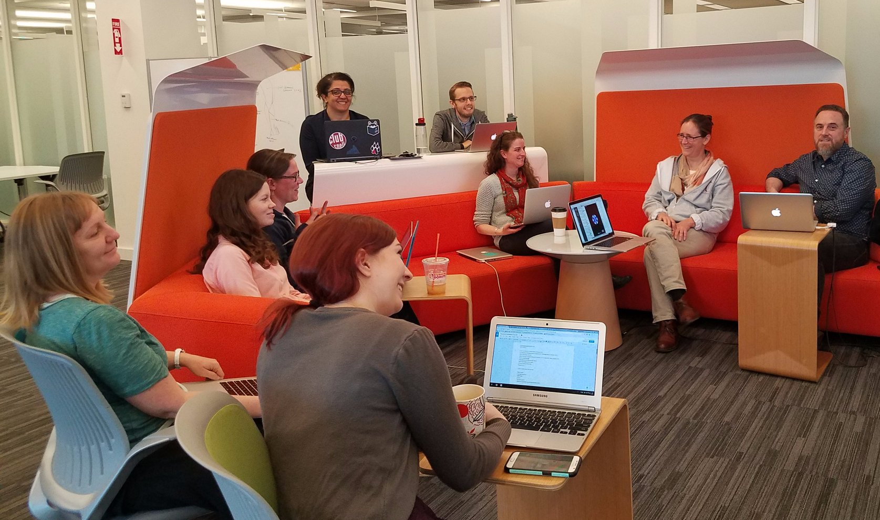
Who We Are
Northeastern University Libraries, Digital Scholarship Group
Text analysis and encoding
GIS
Data visualization
Data management
Repository services
Copyright guidance
Semantic web services

Slide 6

